Slide 1
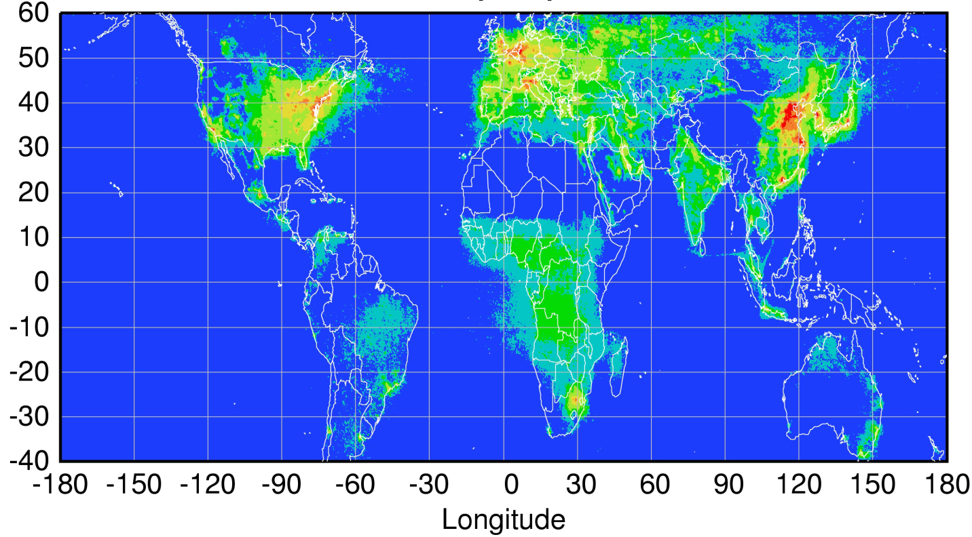
Global pollution monitoring constellation:
Tropospheric chemistry missions funded for launch 2016–2021
Sentinel-4
(hourly)
TEMPO
(hourly)
GEMS
(hourly)
Sentinel-5P
(once per day)
Courtesy Jhoon Kim,
Andreas Richter
Policy-relevant science and environmental services enabled by common observations
Improved emissions, at common confidence levels, over industrialized Northern Hemisphere
Improved air quality forecasts and assimilation systems
Improved assessment, e.g., observations to support United Nations Convention on Long Range Transboundary Air Pollution
1

Slide 2
Funded tropospheric chemistry mission parameters
(as of 4/2015)
 | Europe Sentinel 4 | USA TEMPO | Korea GEMS | Europe Sentinel 5 Precursor TROPOMI
Orbit | Geostationary | Geostationary | Geostationary | Low-Earth
Domain | Europe and surrounding | North America | Asia-Pacific | Global
Revisit | 1 hour | 1 hour | 1 hour | 1 day
Status | Detailed Design, Phase C | Instrument CDR July 2015 | Instrument CDR complete | Instrument delivery 2015
Launch | 2021 (Flight Acceptance Review first instrument) | No earlier than 11/2018 No later than 11/2021 | 2019 | Early 2016
Payload | UV-Vis-NIR 305-500, 750-775 nm | UV-Vis 290-490, 540-740 nm | UV-Vis 300-500 nm | UV-Vis-NIR-SWIR 270-500, 675-775, 2305-2385 nm
Products | O₃, trop. O₃, NO₂, SO₂, HCHO, AAI, AOD, height-resolved aerosol | O₃, trop. O₃, 0-2km O₃, NO₂, HCHO, SO₂, CHOCHO, AOD, AAI | O₃, NO₂, SO₂, HCHO, AOD | O₃, NO₂, SO₂, HCHO, AAI, AOD, height-resolved aerosol, CO, CH₄
Spatial Sampling | 8 km x 8 km at 45N | ≤ 2.22 km N/S x 5.15 km E/W @35N | 3.5 km N/S x 8 km E/W @38N | 7 km x 7 km nadir
Nominal product resolution | 8.9 km N/S x 11.7 km E/W @40N | ≤ 8.88 km N/S x 5.15 km E/W @35N | 7 km N/S x 8 km E/W @38N (gas), 3.5 km N/S x 8 km E/W @38N (aerosol) | 7 km x 7 km nadir
Notes | Two instruments in sequence on MTG-S; use TIR sounder on MTG-S (expected sensitivity to O3 and CO). Synergy with imager on MTG-I w.r.t. aerosol and clouds. | GEO-CAPE precursor or initial component of GEO-CAPE. Synergy with GOES-R/S ABI w.r.t. aerosol and clouds. | Synergy with AMI and GOCI-2 instruments w.r.t. aerosol and clouds. | In formation with S-NPP for synergy w.r.t. clouds and O₃.
Notes:
The limitation of GEO view is the lack of a global perspective
This can be mitigated through international cooperation to form a constellation from GEO
Timing and payloads demonstrate that threshold capability is ready
N. America-Europe-Asia covers the three primary economic/population/emissions regions

Slide 3
Air Quality Constellation Targets:
Harmonization to improve data product quality and usage
During 2013, the CEOS* ACC⁺ AQ Constellation leads developed recommendations for harmonization to mutually improve data quality and facilitate widespread use of the data products
Includes LEO and GEO: LEO observations are a common transfer standard to link the GEO observations
Progress to date includes:
  Sharing of instrument requirements influenced instrument specifications, which may facilitate harmonization of data products
  Advocating open data policy (including L1B) with common formats to facilitate broad usage
  Agreed to use NetCDF format to easily exchange data (4/2015 ACC-11)
  Establishment of new GSICS# UV-Vis subgroup
  AQ Constellation “Geophysical Validation Needs” document is in preparation
*CEOS = Committee on Earth Observation Satellites
⁺ACC = Atmospheric Composition Constellation
#GSICS = Global Space-based Inter-Calibration System

Slide 4
Status of GEMS and TEMPO
Ball Aerospace and Technologies Corp (BATC) is building both instruments
  NASA selected SAO/LaRC/BATC TEMPO proposal under EV-I 1 November 2012
  KARI selected BATC as GEMS Prime Contractor May 13th, 2013
  The instruments have very much in common (e.g., same grating, similar detectors)
Instrument developments are on schedule
  GEMS CDR Feb. 2015, delivery to KARI from BATC spring 2017
  TEMPO CDR June 2015, delivery to NASA May 2017
Mission implementations are very different
  GEMS is an operational mission with 10 year lifetime, scheduled for launch on GEO-KOMPSAT-2B satellite in 2019 (GK2B CDR Jan 2016)
  TEMPO is a PI-led Earth Venture mission with launch/operation to be arranged by NASA (no earlier than 11/2018, no later than 11/2021)
Science teams working together very closely
  Science of GEMS and TEMPO is very similar
  Working together on retrieval algorithms
GEMS data will be assimilated into operational air quality forecast models
  Air quality forecast in operation since 2013 by NIER/ME

Slide 5

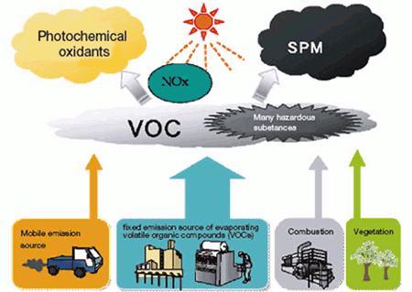
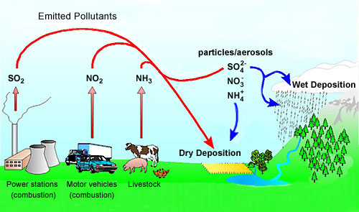
Objective: Measurements of O₃ & aerosol with precursors
hν (λ<345 nm)
O
O₃
HCHO
CHOCHO
hν (<420 nm)
NO
NO₂
Oxidation
(OH, O₃, NO₃)
t~an hour
O₃, RO₂
AOD, type,
Height
Aerosol
Notes:
Formaldehyde (HCHO) is important as a tracer for HOx production,1 and has the potential to provide insight into the nature of convective events. It is one of the most abundant gas phase carbonyls in the atmosphere;2 tropospheric mixing ratios vary typically from 0.2 parts per billion by volume (ppbv) to 20 ppbv,3 depending on elevation and geography, and can reach as high as 60 ppbv.4 Stratospheric HCHO background concentrations are estimated to be much lower (~0.02 ppbv), but current methods lack sufficient sensitivity for a direct measurement. The dominant sources in urban areas include primary emissions from combustion and industrial processing and photochemical oxidation of numerous anthropogenic volatile organic compounds (AVOCs).2,5 Oxidation of biogenic VOCs (BVOCs) becomes important as a source in rural areas,2,5 while methane oxidation provides a source of HCHO (Fig. 1) in the remote troposphere and in the stratosphere.5
HCHO is fairly short-lived (τ ≈ 3 hours)6,7 and is removed from the atmosphere primarily by reaction with OH and by photolysis.2,3 Both of these processes produce HO2,3,6,8,9 and result in a net production of ozone (O3) in the presence of NOx (such as found in polluted urban areas).2 The interaction of HCHO in HOx chemistry has wide-reaching significance. HOx is a major oxidizer throughout the entire atmosphere and is central to catalytic cycles generating O3 in the troposphere and as well as those destroying O3 in the stratosphere, making accurate estimates of these species crucial to atmospheric modeling on both local and global scales.
Because of its implication in HOx cycling, as well as its role as an intermediate in the oxidation of numerous VOCs, HCHO is a useful tracer of the oxidative capacity of the atmosphere. HCHO may provide insight into oxidation processes in complex environments such as the atmosphere above snow-pack, where unexpectedly high OH concentrations have been observed,10 and that within forest canopies.11,12 For the second application, knowledge of HCHO fluxes would be especially useful. Fluxes can be approximated using Monin-Obukhov similarity theory,13 but because of the assumptions required for similarity theory direct HCHO flux measurement by eddy correlation is more desirable, leading to a more accurate closed budget of the species of interest.14–17

Slide 6
Baseline products (16)
Product | Importance | Min (cm⁻²) | Max (cm⁻²) | Nominal (cm⁻²) | Accuracy | Window (nm) | Horiz Resol (km²)@Seoul | SZA (deg) | Algorithm
NO₂ | O3 precursor | 3x10¹³ | 1x10¹⁷ | 1x10¹⁴ | 1x10¹⁵ cm⁻² | 425-450 | 7 x 8 x 2 pixels | < 70 | BOAS DOAS
SO₂ | Aerosol precursor Volcano | 6x10⁸ | 1x10¹⁷ | 6x10¹⁴ | 1x10¹⁶ cm⁻² | 310-330 | 7 x 8 x 4 pixels x 3 hours | < 50 (60*)
HCHO | VOC proxy | 1x10¹⁵ | 3x10¹⁶ | 3x10¹⁵ | 1x10¹⁶ cm⁻² | 327-357 | 7 x 8 x 4 pixels | < 50 (60*)
CHOCHO | VOC Proxy | TBD | TBD | TBD | TBD | 420-260 | 7 x 8 x 4 px | < 50
TropLO3 TropUO3 StratO3 TotalO3 | Oxidant Pollutant O₃ layer | 4x10¹⁷ | 2x10¹⁸ | 1x10¹⁸ | 3%(TOz) 5%(Stra) 20(Trop) | 300-340 | 7 x 8 | < 70 | OE TOMS
AOD AI SSA AEH | Air quality Climate | 0 (AOD) | 5 (AOD) | 0.2 (AOD) | 20% or 0.1@ 400nm | 300-500 | 3.5 x 8 | < 70 | Multi-λ O₂O₂ Ring
[Clouds] ECF CCP | Retrieval Climate | 0 (COD) | 50 (COD) | 17 (COD) |  | 300-500 | 7 x 8 | < 70 | O₂O₂ RRS
Surface Property | Environ- ment | 0 | 1 | - |  | 300-500 | 3.5 x 8 | < 70 | Multi-λ
UVI Solar Ira | Public health | 0 | 12 | - |  |  | 7 x 8 | < 70

Slide 7
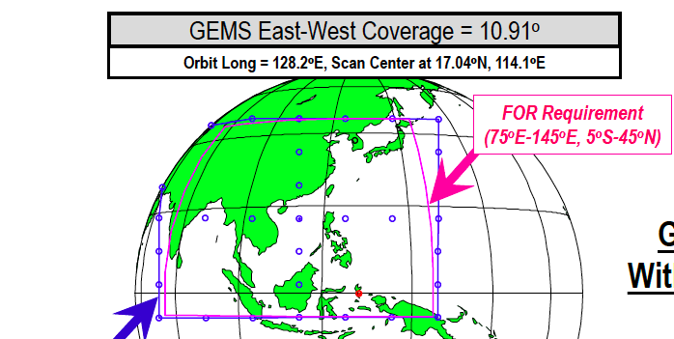
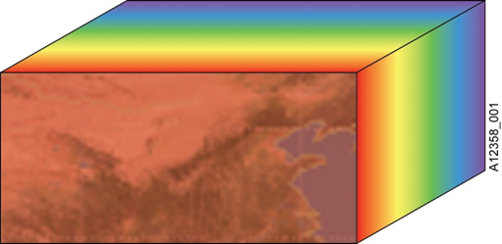
Spatial coverage
λ
y(t)

Slide 8
Science Questions
MAPS-Seoul White Paper
  Scientific Questions for Atmospheric Chemistry (8)
  Air Quality Models and Emission Perspectives (4)
  Satellite Application (3)
NASA KORUS-AQ White Paper
  What are the challenges and opportunities for satellite observations of air quality? (4)
  What are the most important factors governing ozone photochemistry and aerosol evolution? (2)
  How do models perform and what improvements are needed to better represent atmospheric composition over Korea and its connection to the larger global atmosphere? (2)

Slide 9
Integrated KORUS-AQ Science Objectives (1 of 4)
With relation to science questions/objectives of MAPS-Seoul (MS) and NASA KORUS-AQ (NK) white papers
Number | Statement of Objective | White Papers Relation | Measurement Needs | Other Needs
KAQ1 | Establish a ‘baseline’ condition that characterizes O3 and PM air quality relatively free from most local and anthropogenic activities in the SMA | MS1.1, NK2a | Systematic airborne measurements upwind of the SMA
KAQ2 | Segregate the contributions from anthropogenic and natural origins for photochemical oxidants and aerosol species, including biogenic VOC emissions in SMA | MS1.4, MS2.3, NK2a, NK2b, NK3a | Systematic airborne and surface measurements during a range of synoptic regimes, upwind of SMA and within SMA
KAQ3 | Segregate the contributions from different source regions, especially long-range transported vs. local sources: quantify East Asian O3-PM-precursors source-receptor relationships | MS1.4, MS2.2, MS3.1, NK2a, NK2b | Systematic airborne and surface measurements in all synoptic regimes; data from GOCI, OMI/TROPOMI, MODIS, CALIPSO | Models for source/precursor relation
KAQ4 | Observe or determine the production and loss rates of oxidants (Ox, H2O2, RO2, HOx) along VOC/ NOX ratios at different parts of the SMA and downwind regions | MS1.2, NK2a, NK3a | Systematic airborne measurements at multiple airmass ages downwind of dominant source regions

Slide 10
Integrated KORUS-AQ Science Objectives (2 of 4)
With relation to science questions/objectives of MAPS-Seoul (MS) and NASA KORUS-AQ (NK) white papers
Number | Statement of Objective | White Papers Relation | Measurement Needs | Other Needs
KAQ5 | Determine the production rates of secondary aerosols during the photochemically active periods and transported events; determine which precursor species are the main drivers for high aerosol loadings | MS1.3, NK2b, NK3a | Systematic airborne and surface measurements of speciated aerosol composition, number, mass
KAQ6 | Determine how much the nighttime NO3 and Cl radicals contribute to the production of aerosol and photochemical species in consecutive daytime periods | MS1.5 | Systematic nighttime surface NO3 and Cl concentration, Systematic daytime airborne measurements during stagnant meteorological conditions
KAQ7 | Determine how synoptic conditions (outflow, convection, stagnation, etc.) affect the vertical distribution of trace gases and aerosols, and the extent to which surface ozone and aerosol interact with above-surface levels | MS1.6, NK1a | Systematic vertical profile concentration measurements collocated with surface concentration measurements
KAQ8 | Determine how pollutant distributions relate to cloud cover | MS3.2, NK1b | Systematic airborne measurements in a range of clear-sky and cloudy conditions

Slide 11
Integrated KORUS-AQ Science Objectives (3 of 4)
With relation to science questions/objectives of MAPS-Seoul (MS) and NASA KORUS-AQ (NK) white papers
Number | Statement of Objective | White Papers Relation | Measurement Needs | Other Needs
KAQ9 | Determine the effects of heterogeneous chemistries on aerosol and oxidant productions in the SMA | MS1.7, NK2b, NK3a
KAQ10 | Determine the relationship between aerosol properties and their radiative forcing | MS1.8 | Systematic airborne and ground measurements of aerosol physical and radiative properties
KAQ11 | Develop the best-available domestic and foreign anthropogenic emission inventories of O3 and PM precursors and improve them using the field campaign measurements and adjoint inverse modeling. | MS2.1, NK3a, NK3b | Systematic airborne and satellite measurements in all synoptic regimes | Pre-campaign compilation of emission inventories, post-campaign model inversions
KAQ12 | Quantitatively evaluate air quality model processes, including analysis of PM10 and PM2.5 mass closure and diagnosis of the most important contributors to systematic model PM underprediction. | MS2.2, NK3a, NK3b | Systematic airborne and surface aerosol measurements in all synoptic regimes | Air quality model forecasts and analyses

Slide 12
Integrated KORUS-AQ Science Objectives (4 of 4)
With relation to science questions/objectives of MAPS-Seoul (MS) and NASA KORUS-AQ (NK) white papers
Number | Statement of Objective | White Papers Relation | Measurement Needs | Other Needs
KAQ13 | Assess the impact of the marine boundary layer on O3 and PM. | MS2.4, NK1a, NK2a, NK3a | Vertical profiles of measured air pollutants and meteorological parameters in and around Korea, particularly over ocean
KAQ14 | Test GEMS retrieval algorithms under development, including impacts of vertical distribution of trace gases and aerosols on retrieval accuracy and quantification of the effect of clouds on the retrieval of trace gas concentrations | MS3.2, NK1a | Level-1b data of OMI (and/or TROPOMI and/or GeoTASO), vertical distribution of trace gases and aerosols, cloud identification | Radiative transfer and retrieval calculations
KAQ15 | Validate the trace gas products of OMI and OMPS (and/or TROPOMI) and understand the effect of aerosol properties on the retrieval accuracy of NO2 | MS3.3, NK1c | Column and vertical profile trace gas and aerosol observations from ground-based and airborne platforms at times and locations of satellite observations, cloud identification | Radiative transfer and retrieval calculations
KAQ16 | Validate the aerosol products of GOCI, MODIS, OMI and other relevant satellites and understand how the land/water boundary influences aerosol retrievals | MS3.3, NK1d | Column and vertical profile aerosol observations from ground-based and airborne platforms at times and locations of satellite observations, cloud identification | Radiative transfer and retrieval calculations

Slide 13
Backup

